Slide 1
Sustainable food systems
Data exploration and modelling
Patricia Alvarez & Harold Achicanoy

Slide 2
Overall picture
Initial number of countries with at least one variable with data: 248
Variables measured in one specific year
Variables measured through time:
We choose the most recent year with the highest number of data around for all countries
We calculate an average per period (~10 years) in order to get more number of data
Number of countries with complete data: 36
… missing data

Slide 3
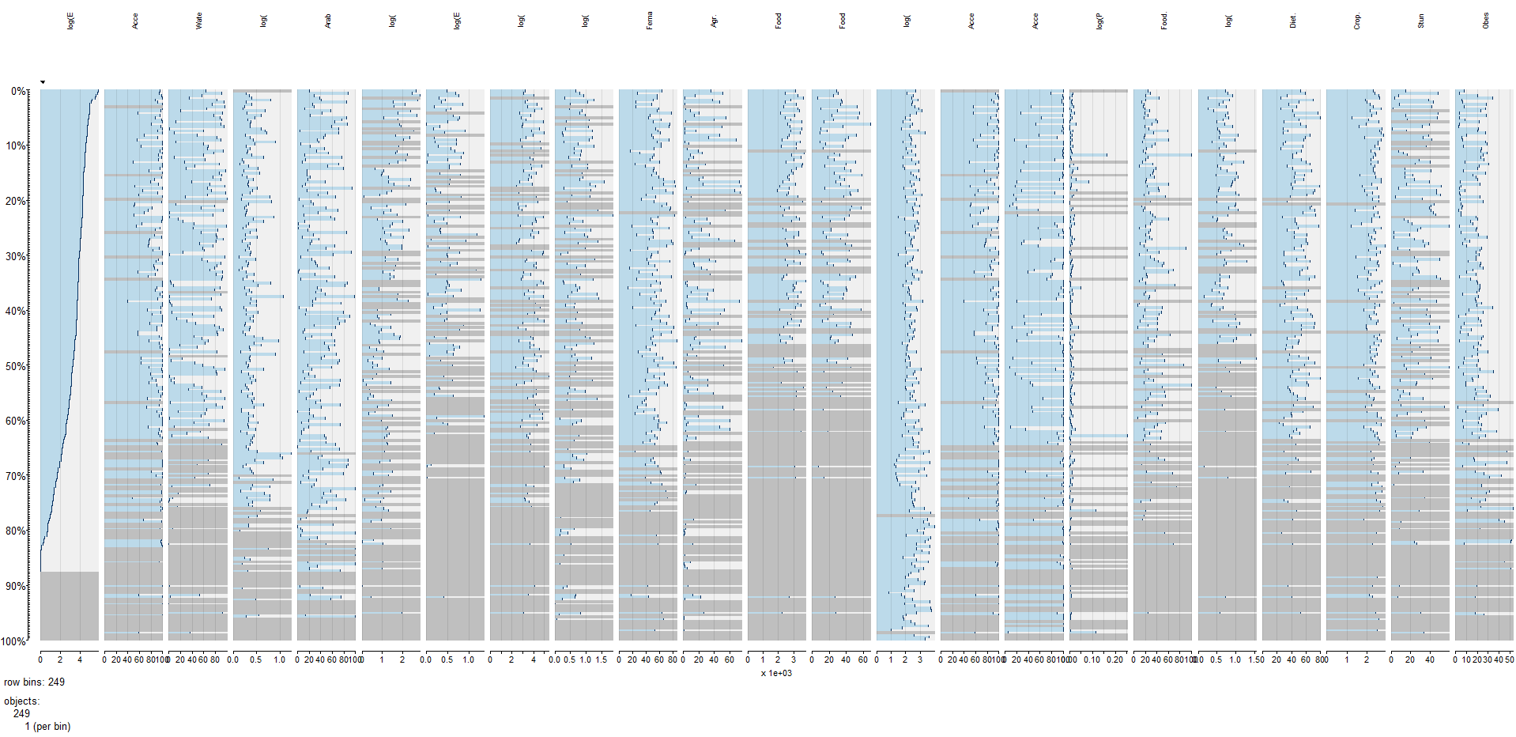
Overall picture
Number of countries with complete data: 36
Environmental dimension
Economic dimension
Social dimension
Food and nutrition dimension
7 indicators
2 indicators
12 indicators
2 indicators

Slide 4
Missing data management (proposal)
Go to the link

Slide 5
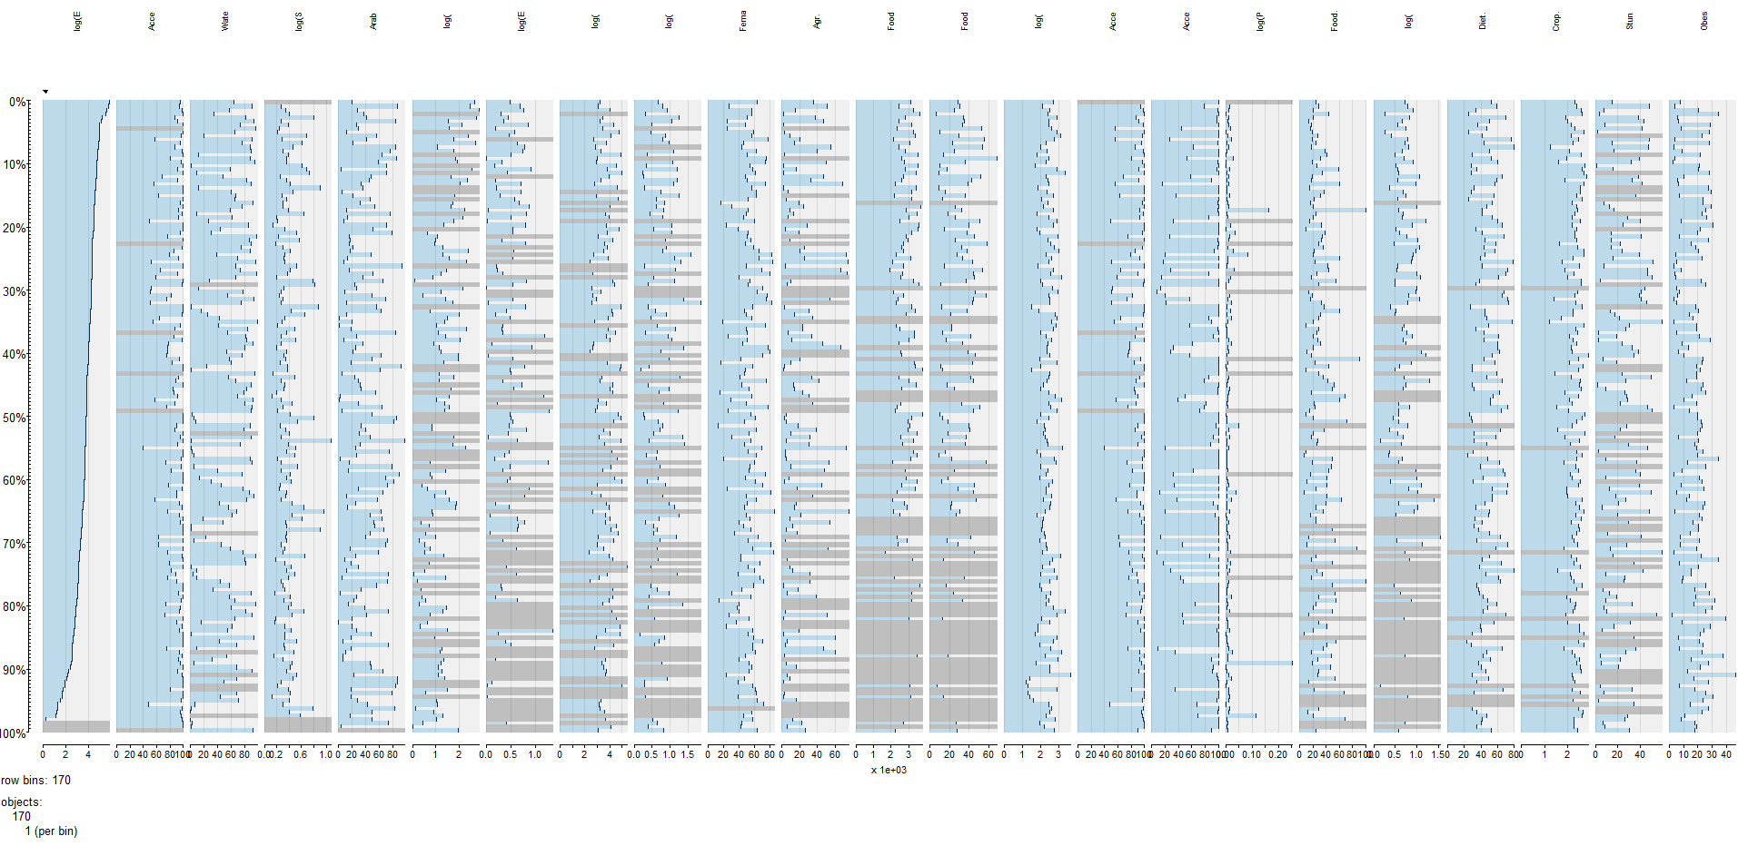
Overall picture
Number of countries: 170
Environmental dimension
Economic dimension
Social dimension
Food and nutrition dimension
7 indicators
2 indicators
12 indicators
2 indicators

Slide 6
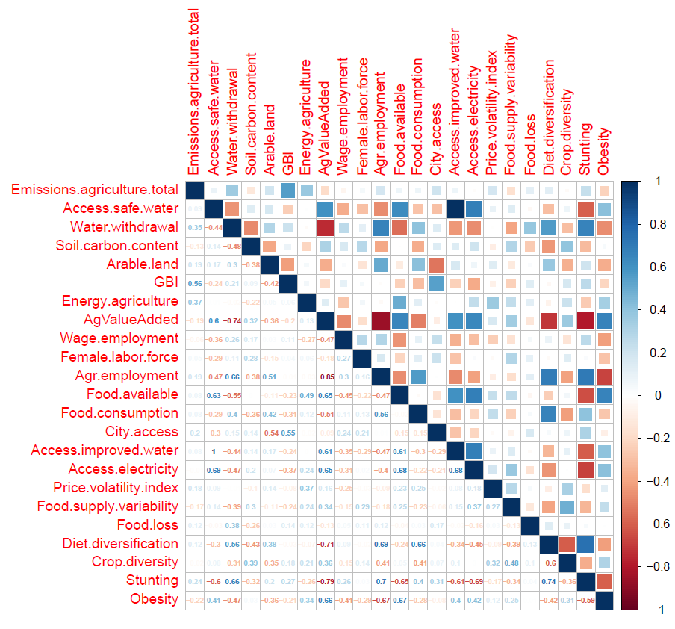
Exploring data
Environmental dimension
Economic dimension
Social dimension
Food and nutrition dimension

Slide 7
Fitting models
Complete data
Missing data imputed

Slide 8
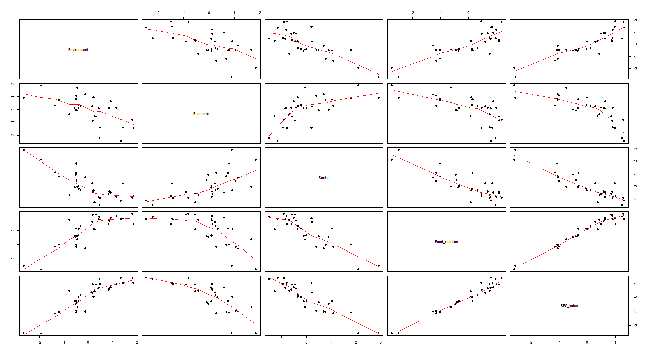
Fitting models

Slide 9
Sustainable food systems (updates)

Slide 10
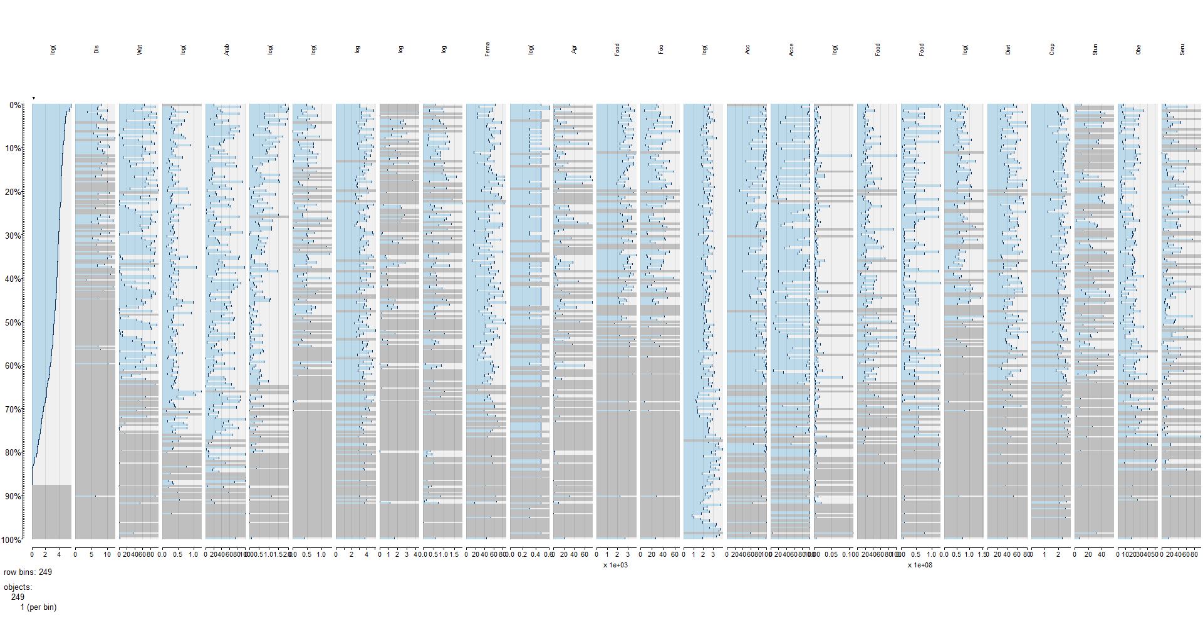
Overall picture
Number of countries with complete data: 10
Environmental dimension
Economic dimension
Social dimension
Food and nutrition dimension
7 indicators
3 indicators
3 indicators
14 indicators

Slide 11
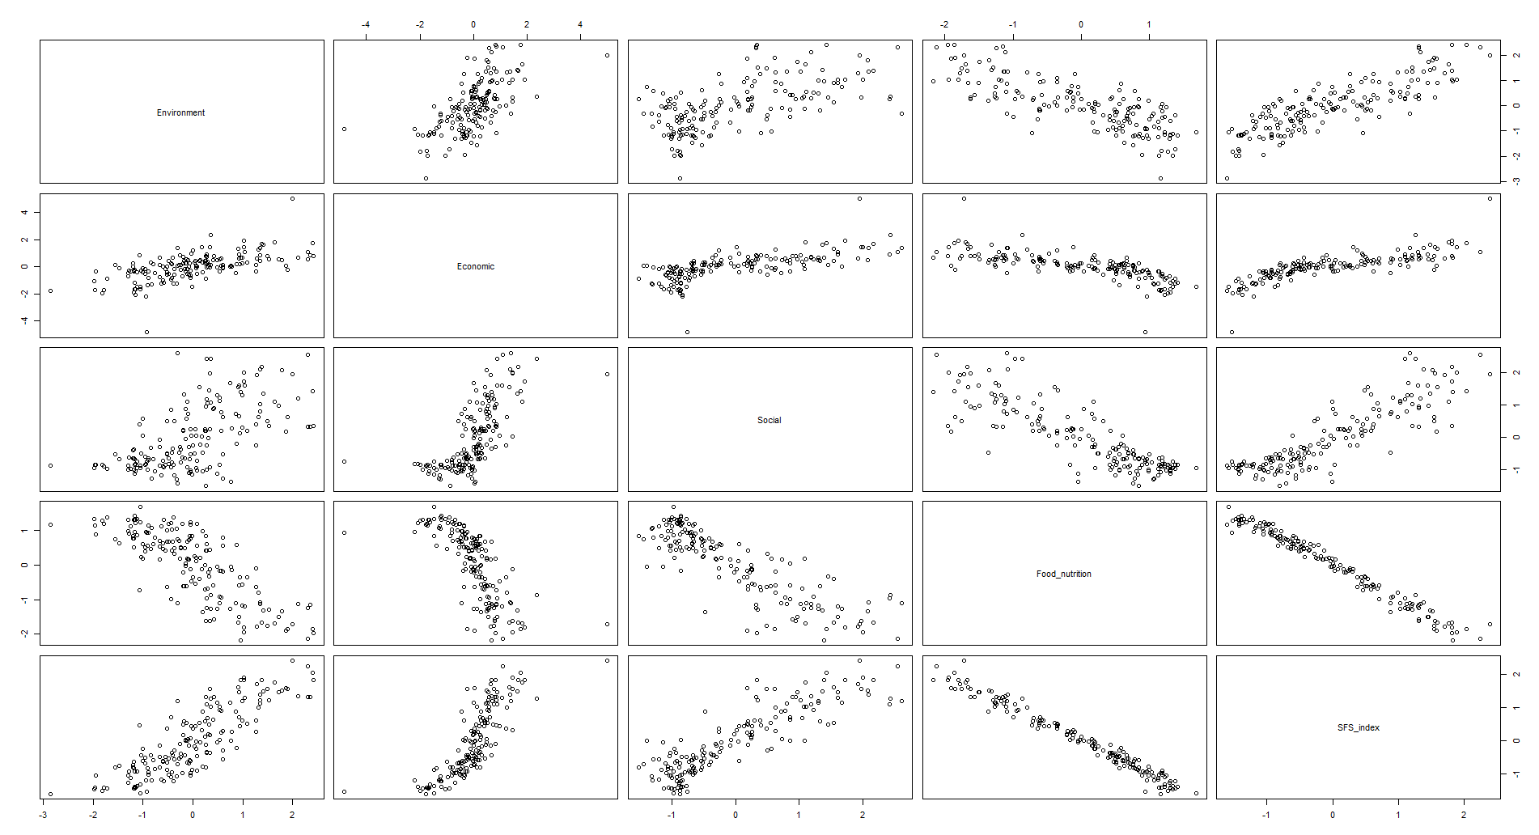
Fitting models

Slide 12
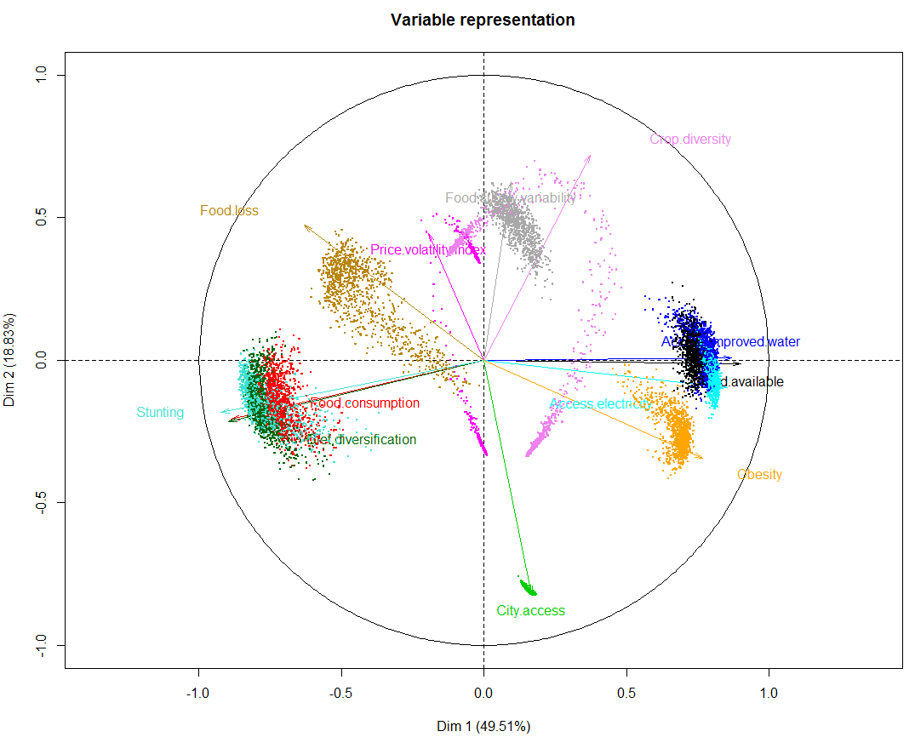
Just for Food and nutrition dimension

